Slide 1

C# Tips and Tricks

Slide 2
Table of contents
Traps
Syntactic sugar and Language Features in C#
Useful .NET classes and methods
Debugging and testing tips
Demos: https://github.com/NaskoVasilev/CSharp-Tips-and-Tricks

Slide 3
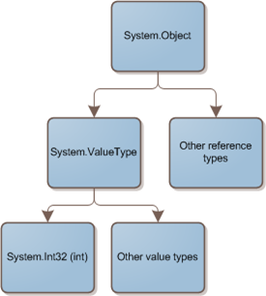
Equality in .NET
Value equality
The generally understood meaning of equality
Two objects contain the same value
E.g. two integers with the same value
have value equality
Reference equality
Also know as identity
Two objects references refer to the same object

Slide 4
Check references in .NET
To check for reference equality use ReferenceEquals (return Boolean)
Object.ReferenceEquals(firstObject, secondObject);
To check for value equality, you should generally use Equals
Equals as it is implemented by Object just preforms a reference check (we should override it)
firstObject.Equals(secondObject) // true or false
By default, the operator == tests for reference equality (override it for immutable types)
firstObject == secondObject // true or false

